Slide 1




Adjudication Board - Presentation
NUST - PNEC
AUTONOMOUS SLAM BASED INTERACTIVE BOT
with Object Avoidance, Human Interaction, and Real-Time User Integration

Slide 2


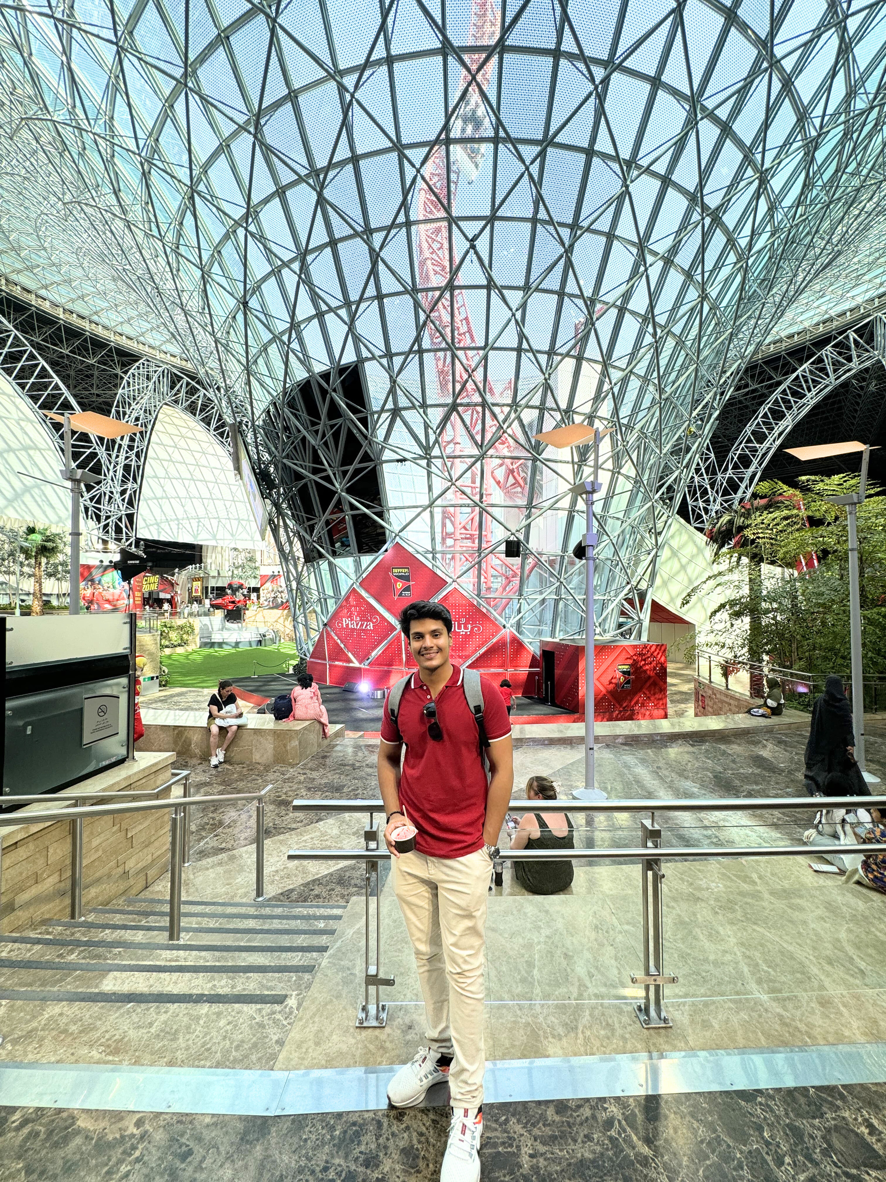
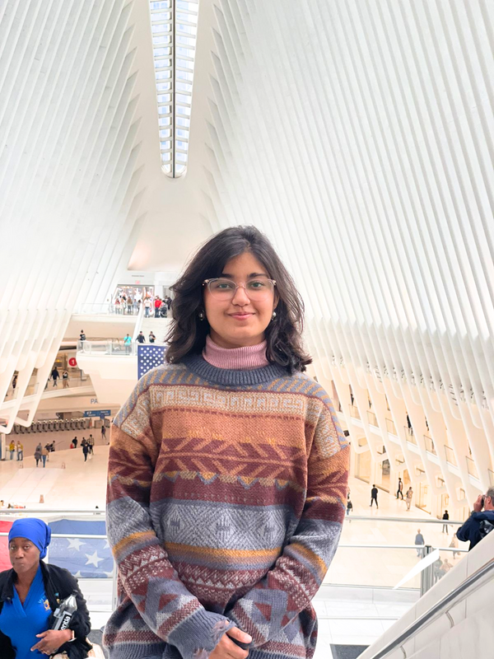

Project
Team
Supervisor:
CDRE Dr Attaullah Memon
Khadeeja Khan
Hassaan Muhammad Khan
Narmeen Sabah Siddiqui
Abdul Rafey Beig

Slide 3

Key Discussion
Points
1
Introduction
2
Problem Statement
3
Solution
4
System Architecture
5
Future Work
6
Methodology
7
Deliverables
8
Work Division
9
Timeline

Slide 4

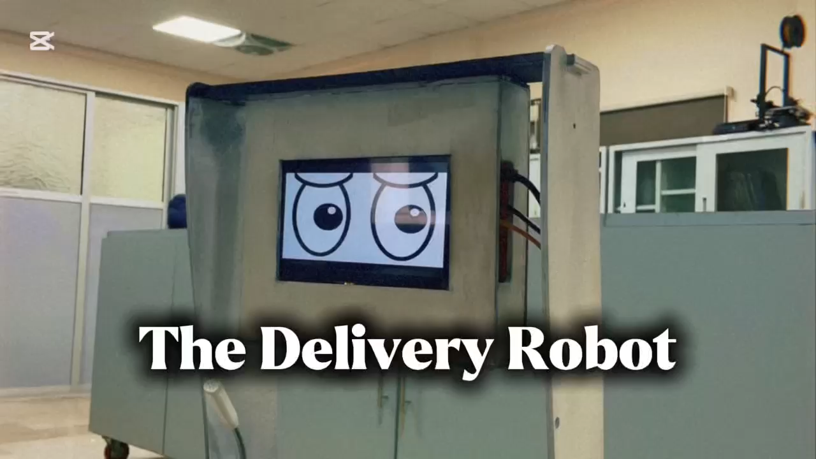

Slide 5

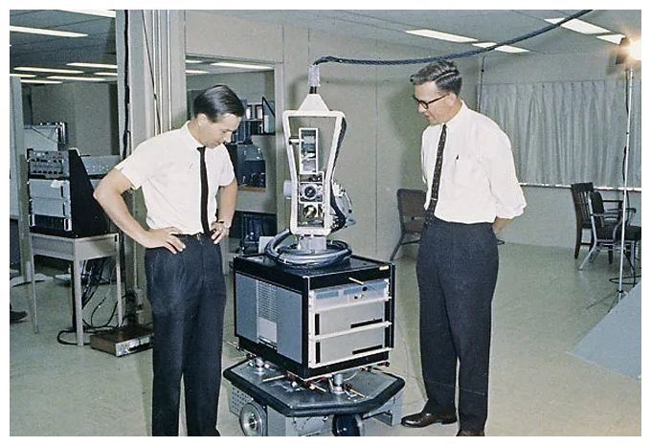
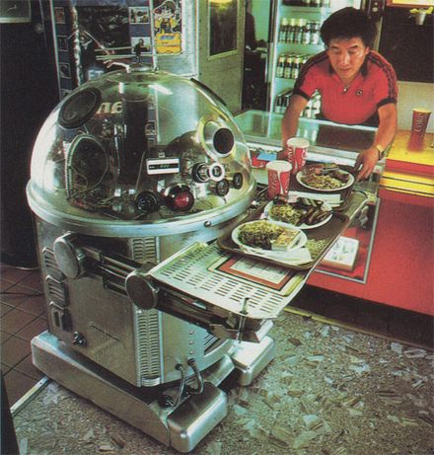
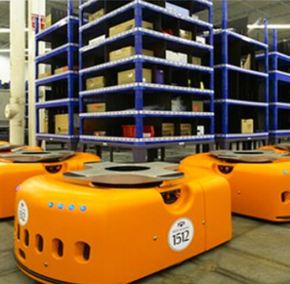
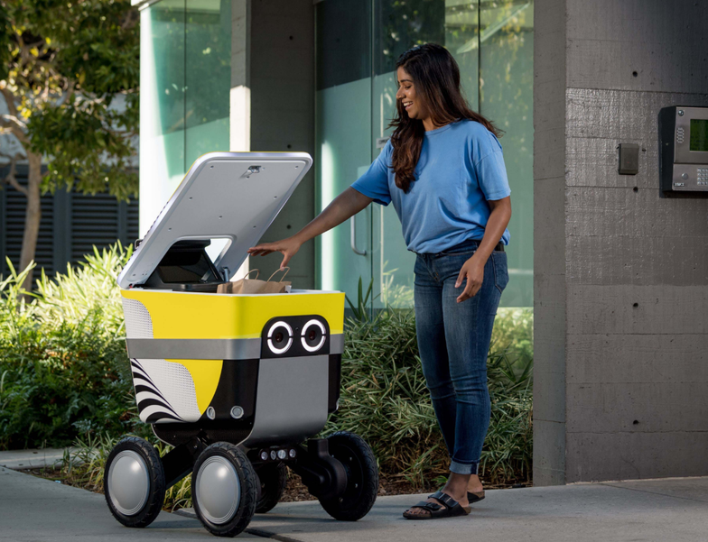
Shakey The Robot (1968)
Tanbo - R1
(1983)
Kiva Systems Robot (2003)
KiwiBot
(2022)

Slide 6

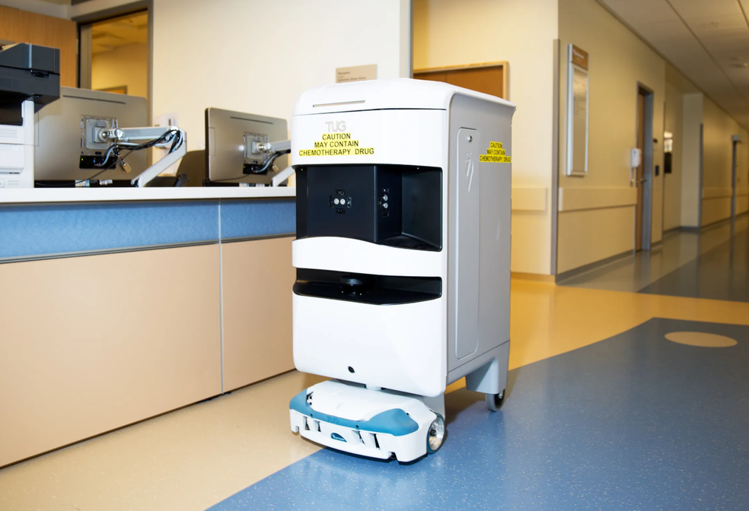
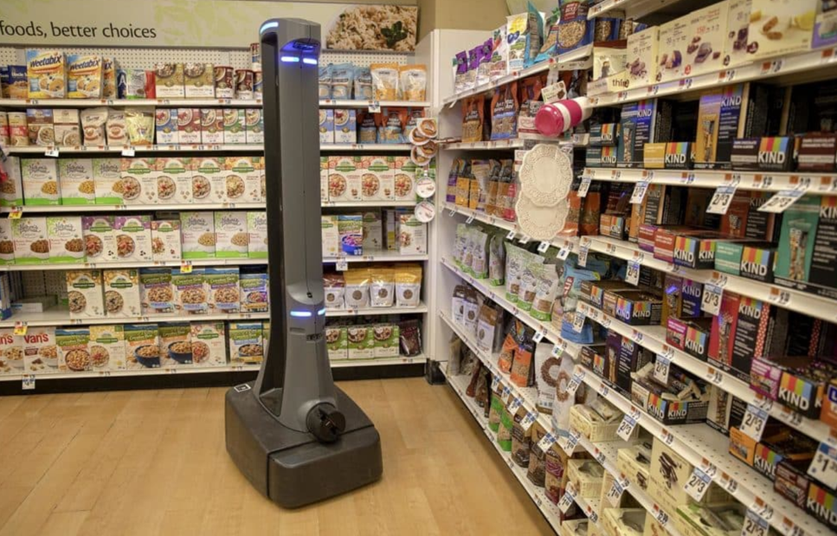
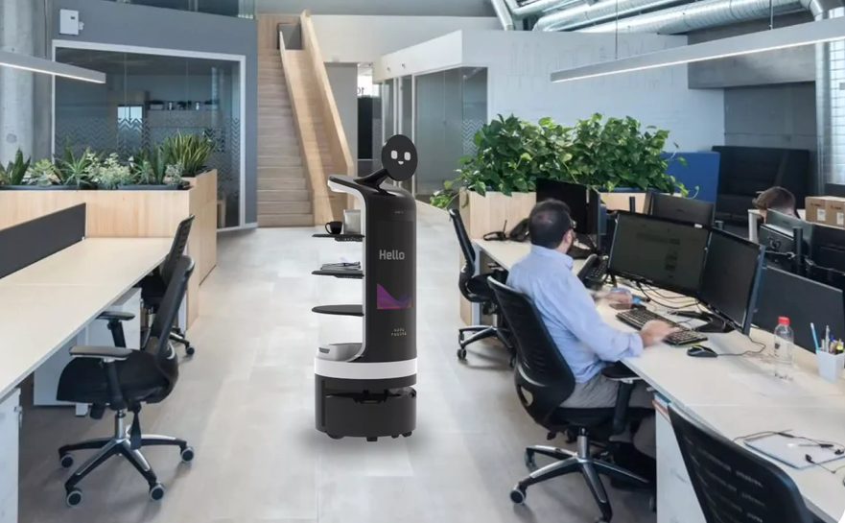
Hospitals
Supermarkets
Food Industry
Office Assistant

Slide 7
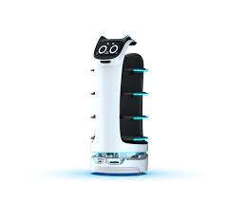
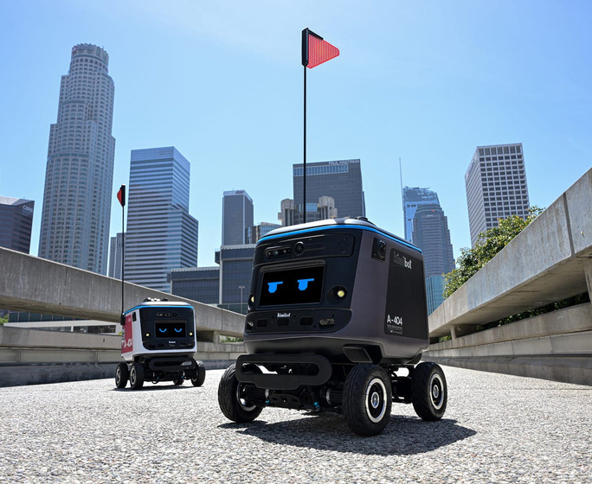
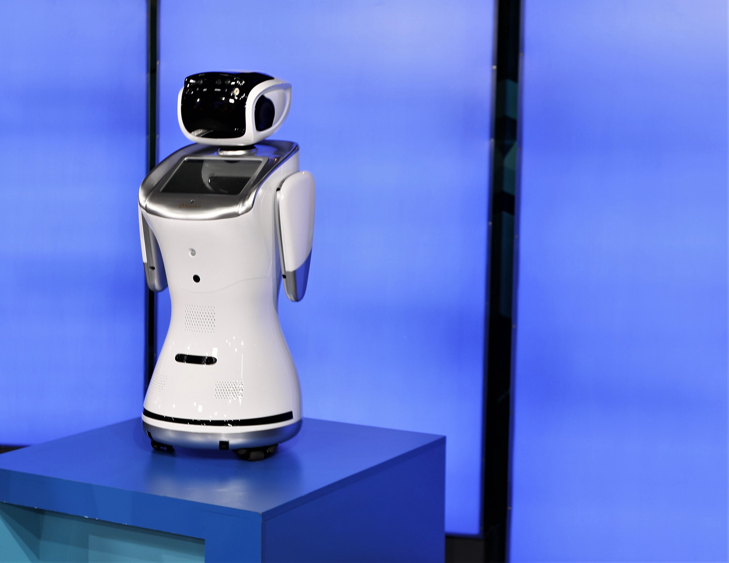
Bella Bot (China)
KiwiBot (USA)
San Bot (Japan)
Despite their global presence and proven efficiency, these robots remain non-existent in Pakistan.

Slide 8
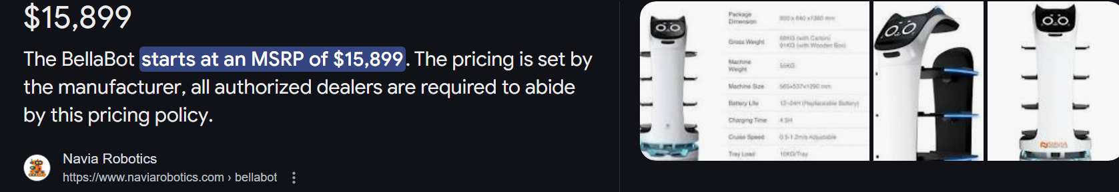
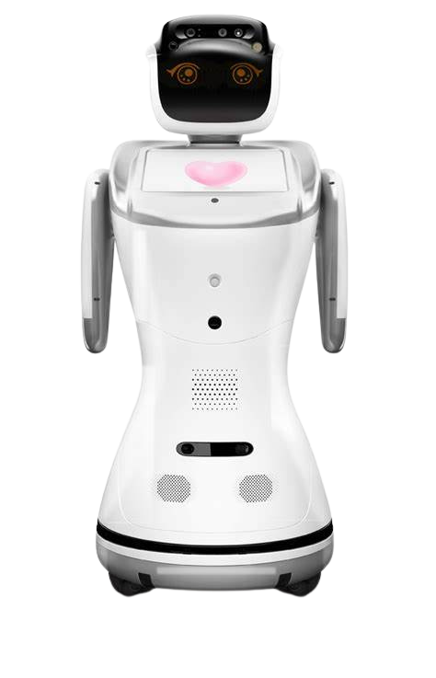
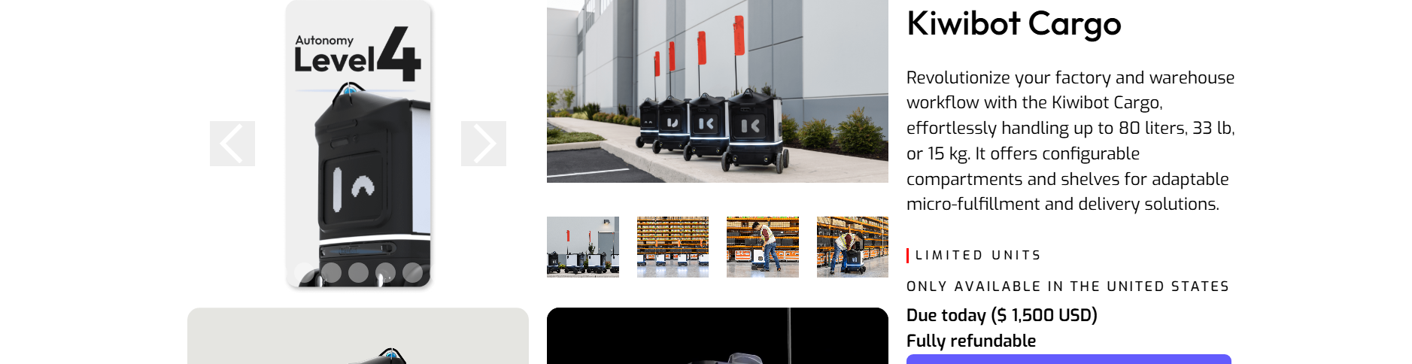

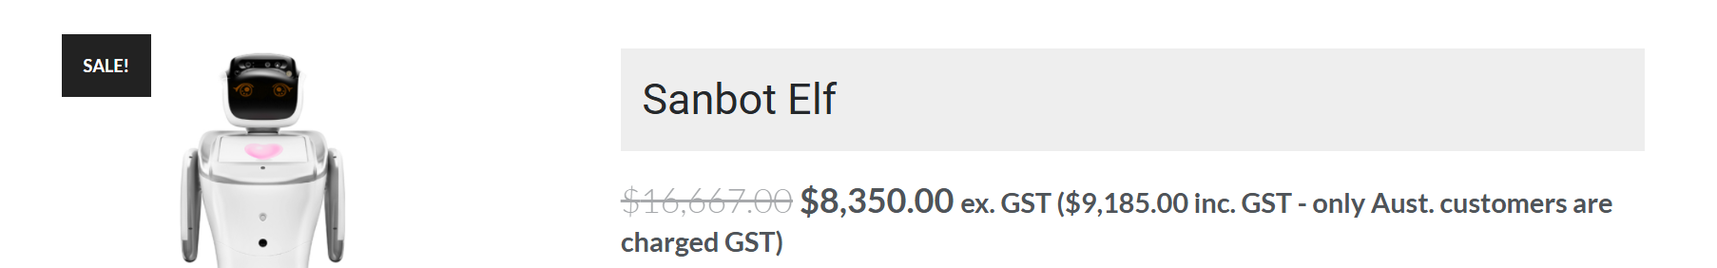

Slide 9


The Goal
Design and development of a general-purpose autonomous mobile assistant robot that integrates
LiDAR-based SLAM for autonomous navigation
Human Robot Interaction
Adaptive functionality for various environments

Slide 10






Autonomous Mobility
Mechanical Structure
AI/ML Driven Interactions

Slide 11
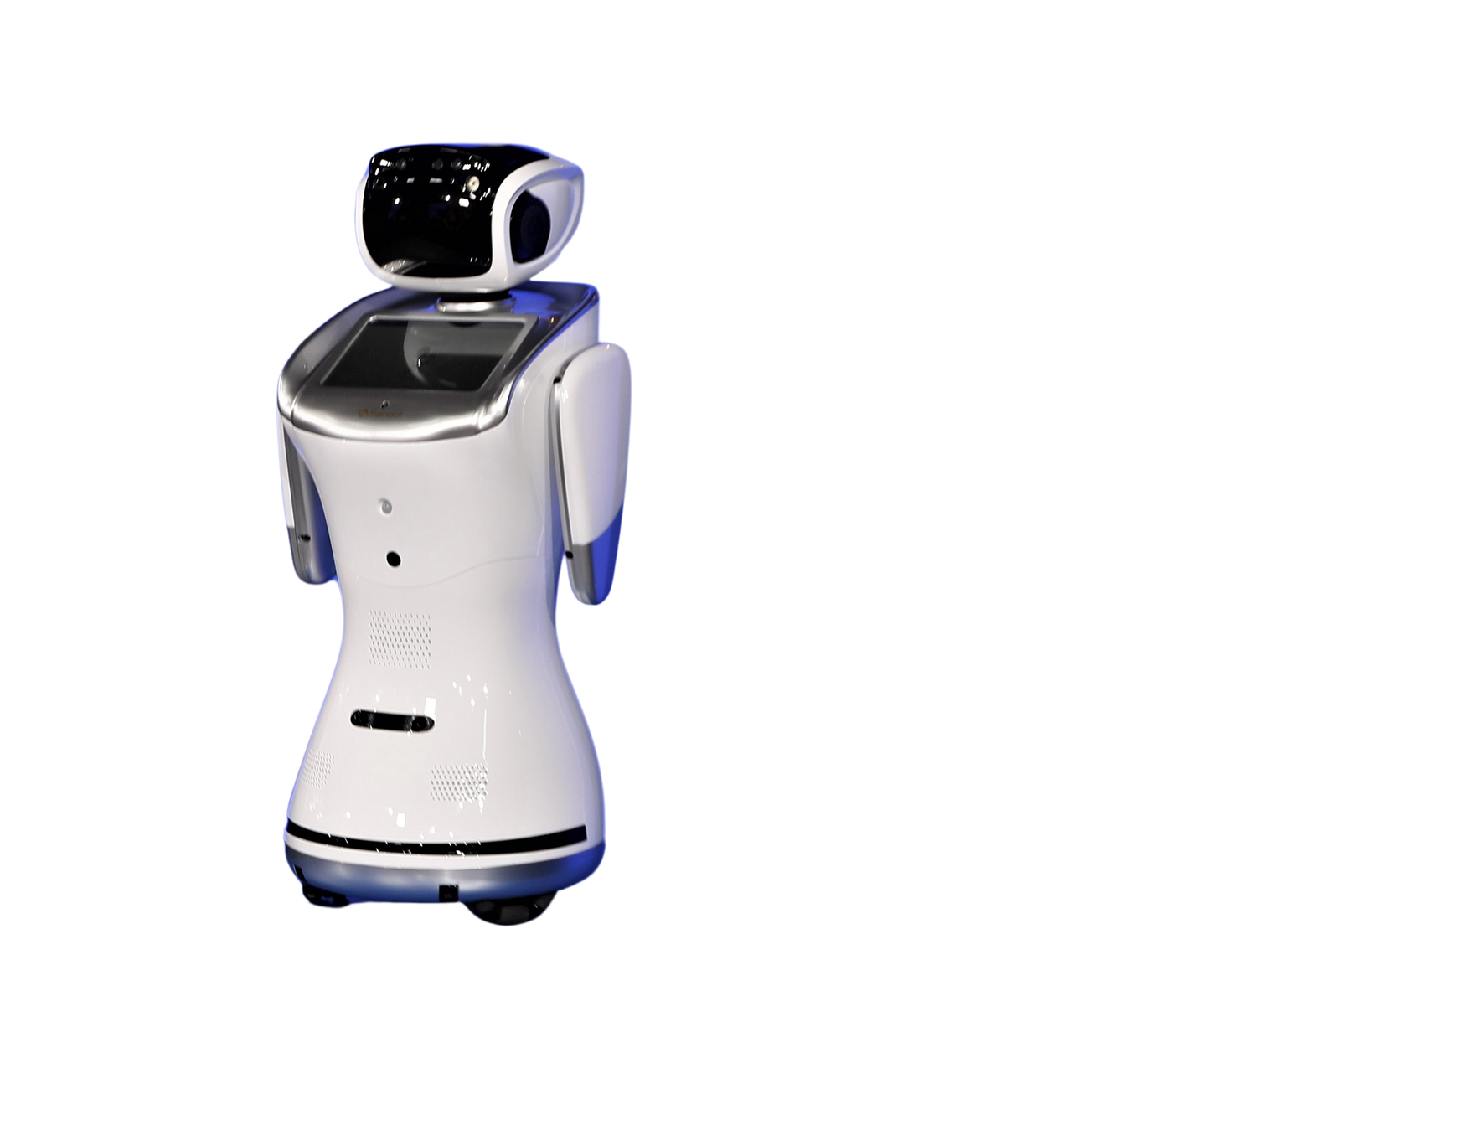
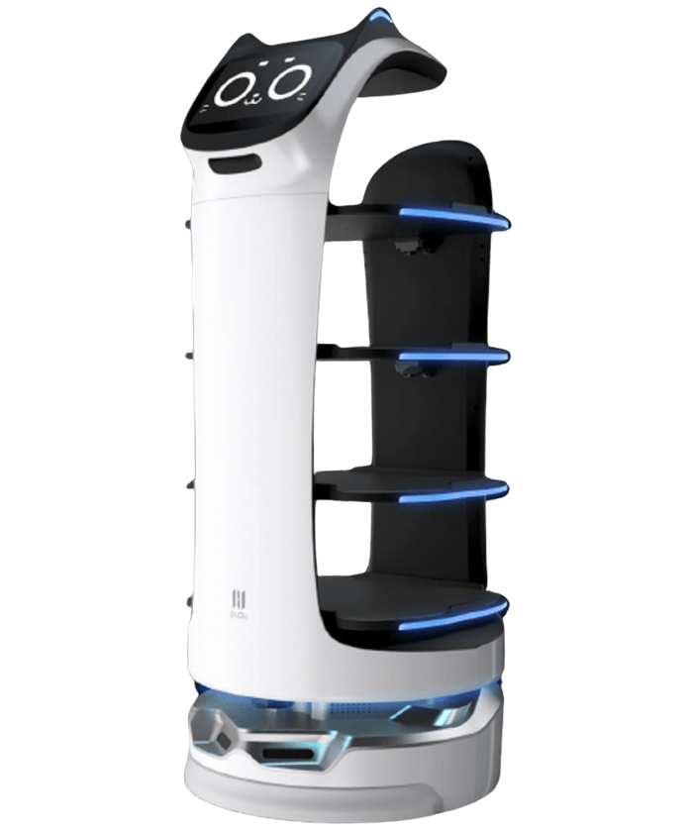
Mechanical Structure

Slide 12




Mechanical Structure
Structure Style?
Material?
LiDAR Placement?
Height?
Payload?

Slide 13
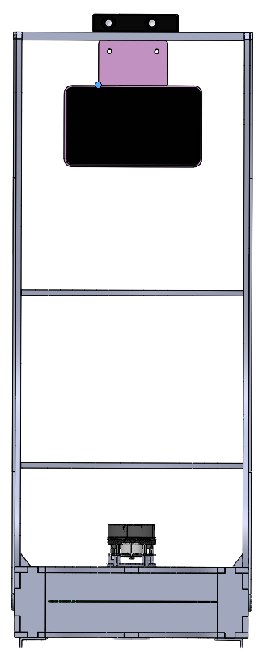
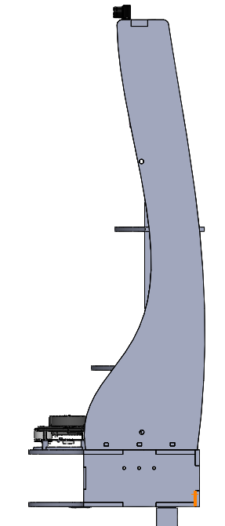
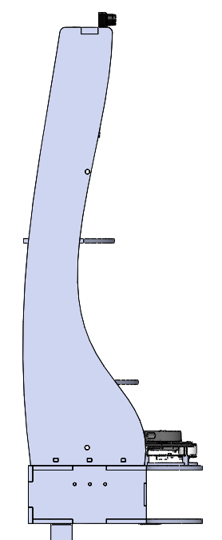
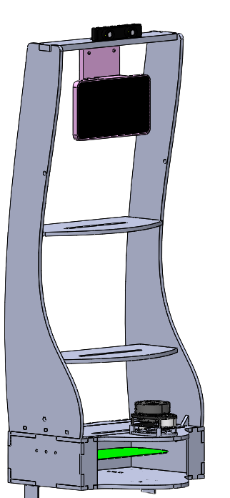
Initial Prototype: Laser Cut Plywood
That can support 3kgs

Slide 14
Autonomous Mobility
Mechanical Structure
AI/ML Driven Interactions

Slide 15
Autonomous Mobility

Slide 16
Autonomous Mobility
Ability to move from point A to point B on its own
Simultaneous Localisation and Mapping (SLAM)
Localisation
Mapping

Slide 17
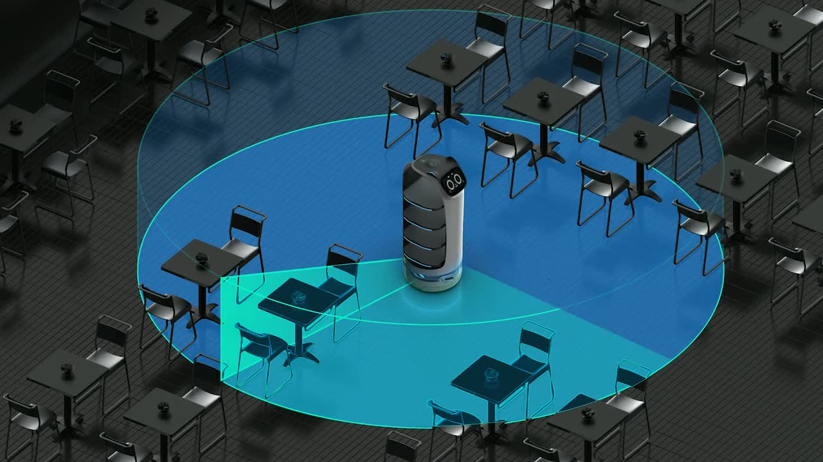
Autonomous Mobility
Approach
Laser Based SLAM
Point Cloud Generation
Use of Lidar Technology
High Precision
Independent of light Conditions

Slide 18
Autonomous Mobility
Ability to move from point A to point B on its own
Navigation Algorithms

Slide 19
Autonomous Mobility
Ability to move from point A to point B on its own
Navigation Algorithms
A* and Hybrid-A*
(SmacPlanner)
Dijkstra’s
(NavFnPlanner)

Slide 20
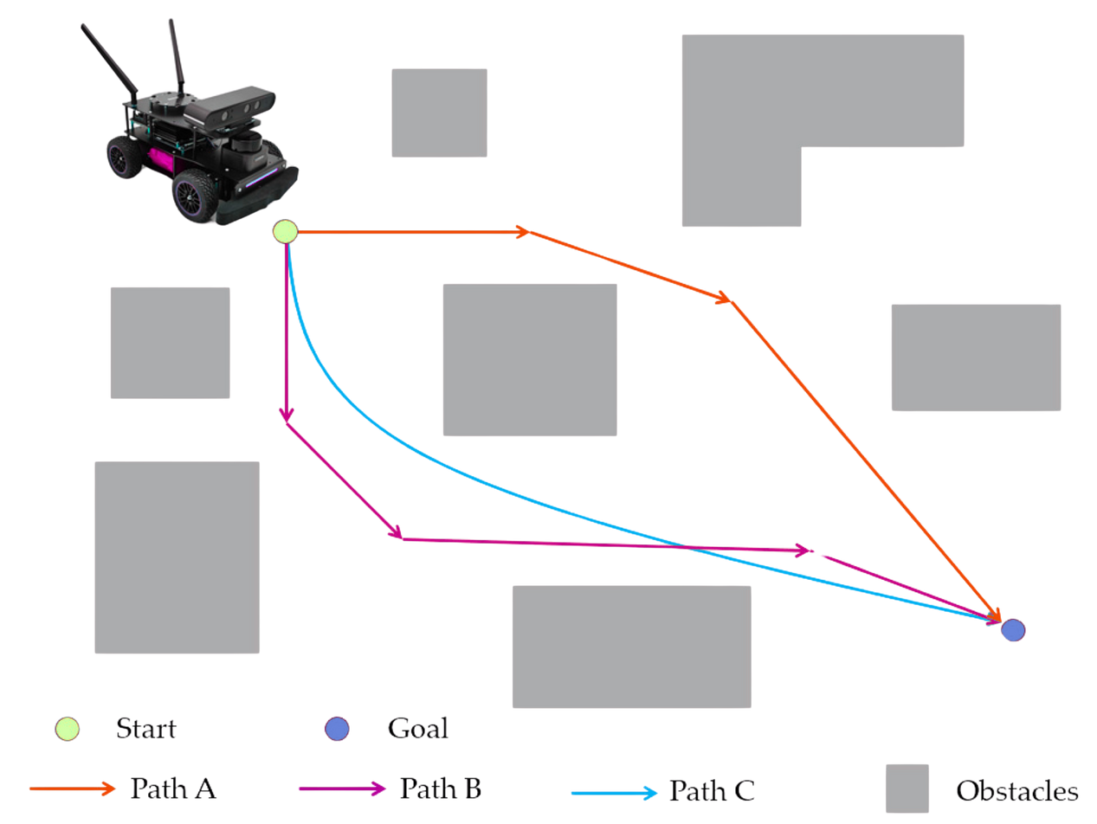
Autonomous Mobility
Approach
Dijkstra’s Algorithm
Conservative Path Planning
Higher Safety Margins
Predictable and Stable Behavior
Better Integration
start
goal
path A
path B
path C
Obstacles

Slide 21
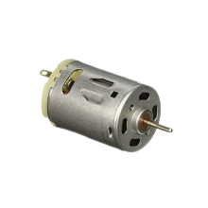
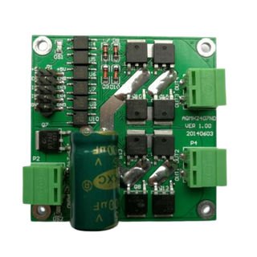
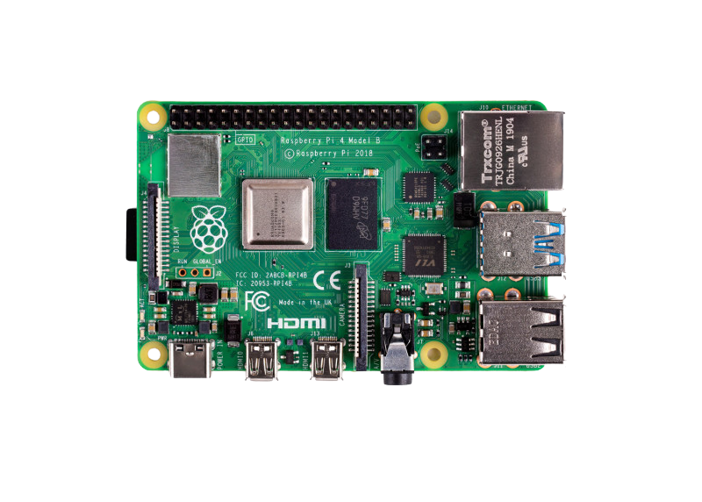
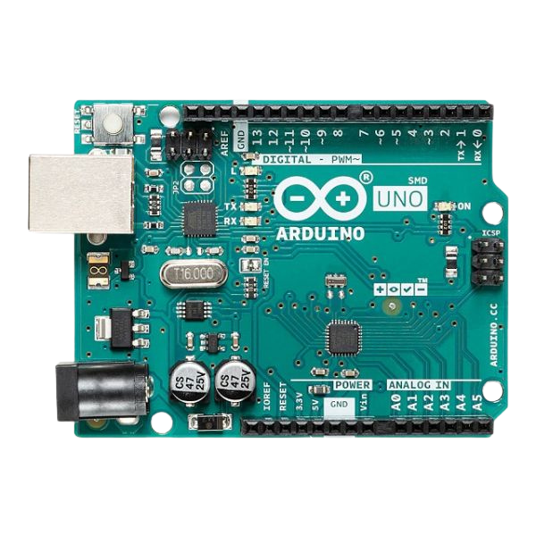

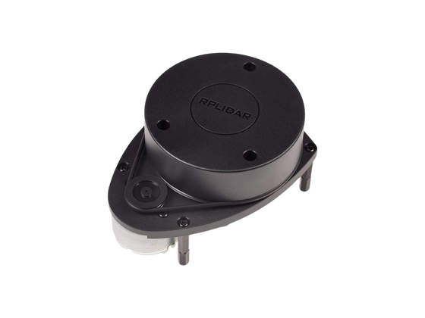
Autonomous Mobility (Recap)
Hardware Connections
Encoder 2
PWM
PWM
SSH
USB A
Host Computer
USB- B
Encoder 2

Slide 22


Autonomous Mobility (Recap)
System Diagram
SLAM
Point Clouds
Odometry Data
Navigation
Motion Controller
Data Acquisition
Encoder
Velocity Commands
Motor RPM
Encoder Pulses
PWM and direction signal
on/off

Slide 23
Autonomous Mobility (Recap)
ROS2 based Software Stack
Control Algorithms
Teleoperation Node
launch_robot.launch.py
Robot State Publisher
ROS2 Control Node
command velocities
\cmd_vel
\robot_description
LiDAR
\scan
odometry
\odom
rplidar.launch.py
transforms
\tf2
Rviz2
SLAM Toolbox
\map
\scan
\tf
NAV2 Bringup Node
online_async_launch.py
\costmap

Slide 24
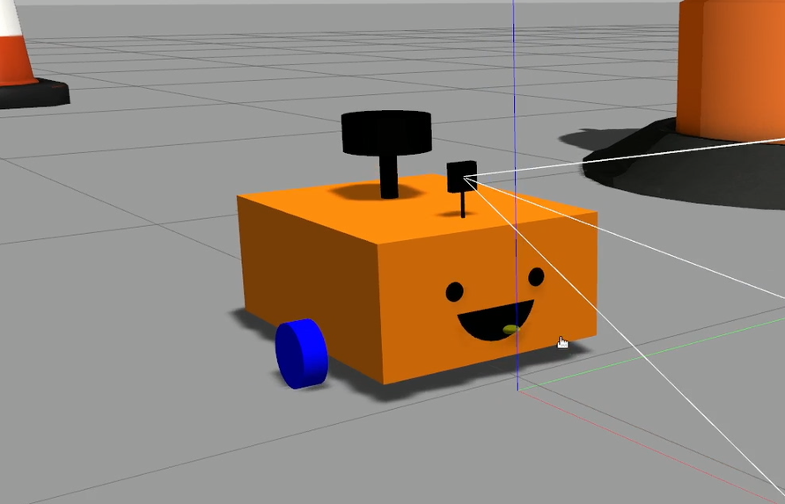
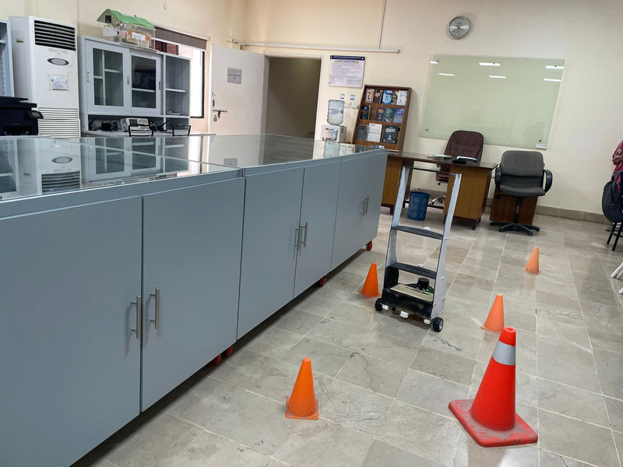
Autonomous Mobility
Whats New?
Simulation
Real World
Virtual environment
Virtual testing
Real world environment (FYP Lab)
Real world testing & obstacle avoidance

Slide 25
Autonomous Mobility
Challenges & Solution
Static Obstacle Avoidance
Dynamic Obstacle Avoidance
Navigating Tight Spaces
Robot as an obstacle (LiDAR FOV filtering)

Slide 26
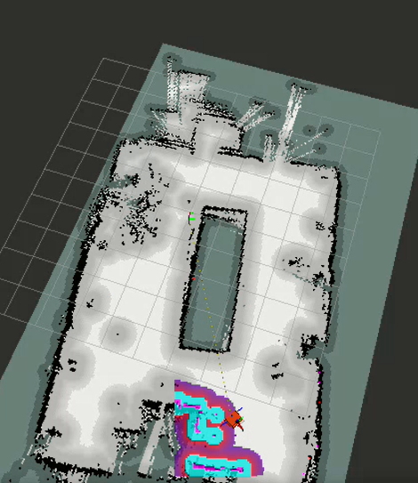
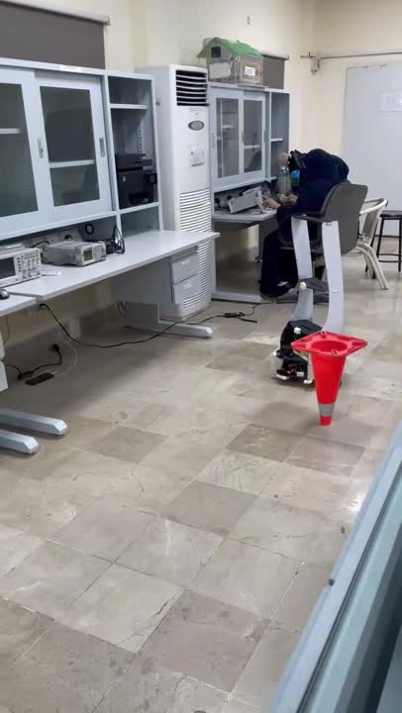
Static Obstacle Avoidance
Solution: Map generated using SLAM
Surrounding obstacles are realized only when the goal pose
i.e the target location is given

Slide 27
Autonomous Mobility
Challenges & Solution
Static Obstacle Avoidance
Dynamic Obstacle Avoidance
Navigating Tight Spaces
Robot as an obstacle (LiDAR FOV filtering)

Slide 28
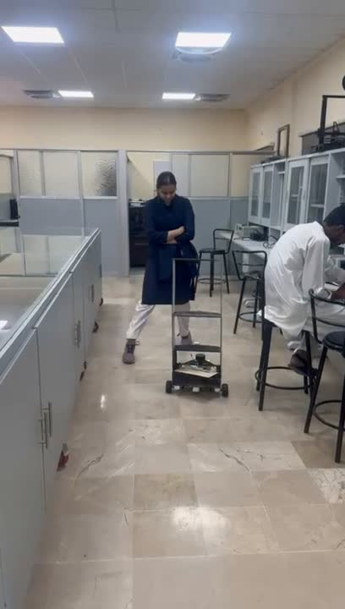
Dynamic Obstacle Avoidance
Solution: Realtime Mapping and Navigation
Obstacles realised during the execution of Navigation algorithm as well!
E.g: People moving in a restaurant

Slide 29
Autonomous Mobility
Challenges & Solution
Static Obstacle Avoidance
Dynamic Obstacle Avoidance
Navigating Tight Spaces
Robot as an obstacle (LiDAR FOV filtering)

Slide 30
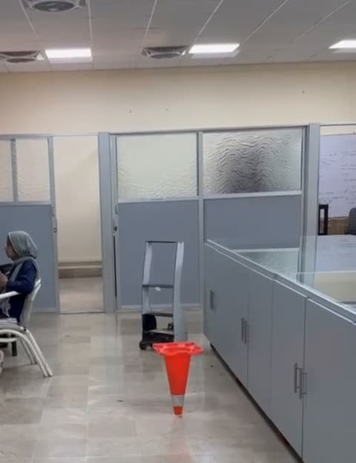
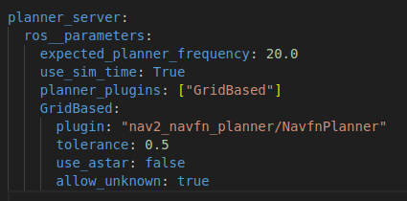
Navigating Tight Spaces
Solution: Parameter Tuning
Tolerance tuning: 0.5m to 0.3m
Costmap Update Frequency: 10Hz
Control Loop Rate adjustment: 20 Hz

Slide 31
Autonomous Mobility
Challenges & Solution
Static Obstacle Avoidance
Dynamic Obstacle Avoidance
Navigating Tight Spaces
Robot as an obstacle (LiDAR 360 fov)

Slide 32
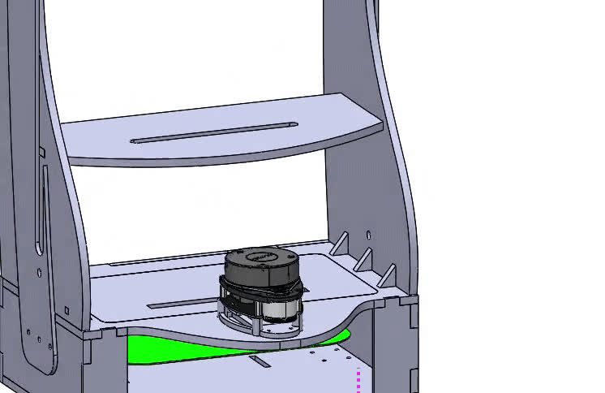
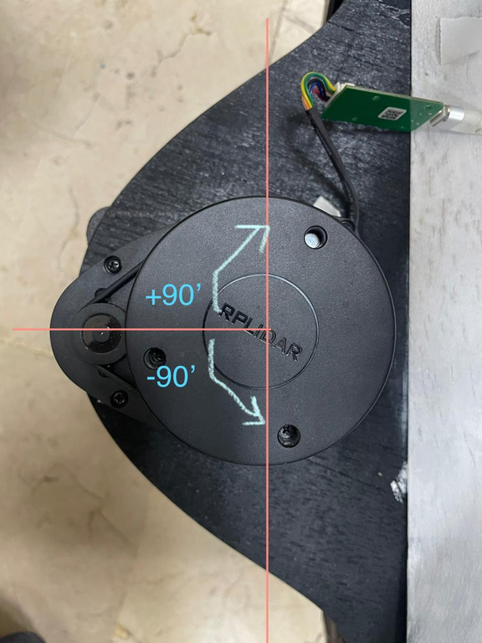
Robot as an obstacle (LiDAR 360 fov)
Solution: LiDAR Field of View Filtering
Limiting the LiDAR field of view to be within +90 and -90 degrees

Slide 33
Autonomous Mobility
Mechanical Structure
AI/ML Driven Interactions

Slide 34



AI/ML Driven Interactions
Visual and Audio Interaction
Display Expressions
Conversational AI

Slide 35

AI/ML driven interactions
Conversational AI
Person detection
Conversational AI
Live video feed from webcam
Chatgpt API
YOLOV8
checks each frame
detects for threshold >80
Responds through pyttx and google speech recognition

Slide 36

Hurdles
Computational Limitations of Jetson Nano and Raspberry Pi
Understanding the mechanical design and manufacturing from scratch
Power Outages During Final Testing Phase

Slide 37



Final Outcomes
The First Prototype
Mechanical Structure
Object Avoidance
Fully Autonomous Navigation
Conversational AI
Gesture Replication

Slide 38


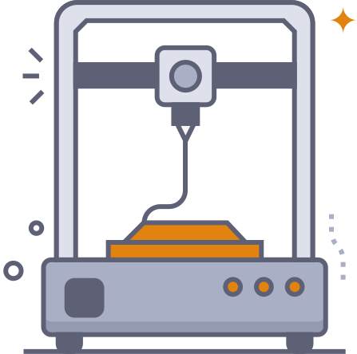

Future Work
Improved Structure
Better Human Robot Interaction
Sensor Fusion
GUI Development

Slide 39
Future Work
Improved Structure
Better Human Robot Interaction
Sensor Fusion
GUI Development

Slide 40
Future Work
Improved Structure
Better Human Robot Interaction
Sensor Fusion
GUI Development

Slide 41
Future Work
Improved Structure
Better Human Robot Interaction
Sensor Fusion
GUI Development

Slide 42


Business Dimension
Robot as a Service (RaaS)
On-Premise Robotic Model

Slide 43

Budget
Total : PKR 123,500

Slide 44
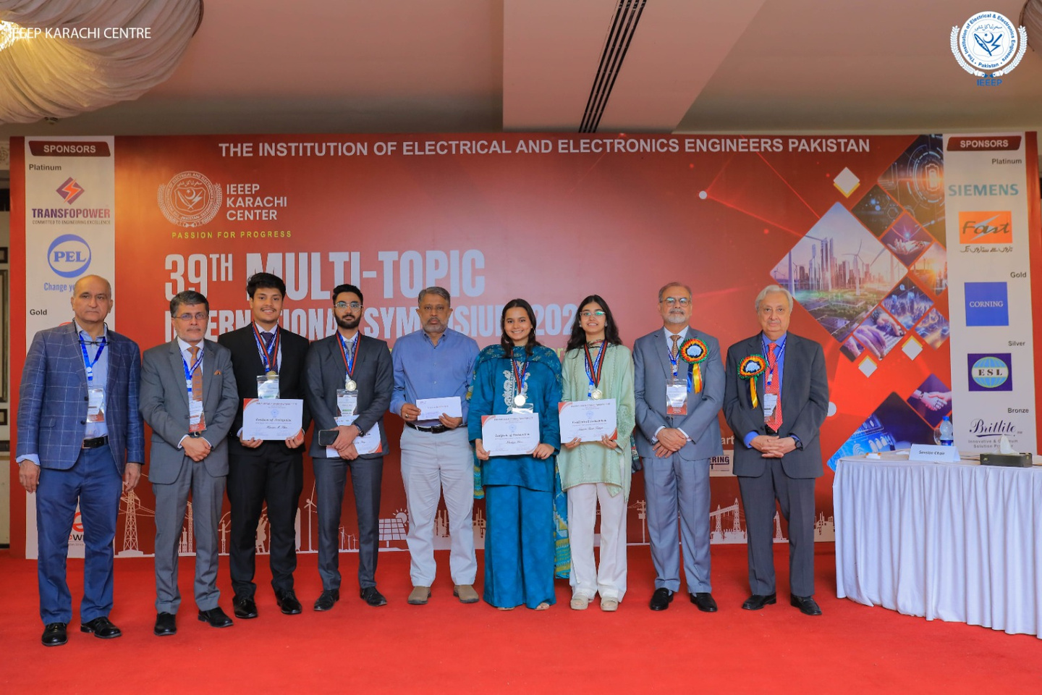


Notable Achievements
(Winners)
60+
20
3
Papers Submitted
Shortlisted for 2nd round
Winners in the Gold Category
Presented in Round 2

Slide 45
Work
Division
Khadeeja Khan | Narmeen Sabah Siddiqui | Hassaan Muhammad Khan | Abdul Rafey Beig
Mechanical Design | Mechanical Design | Hardware integration | ROS Setup and SLAM
Navigation | Electrical Circuitry | LLM Integration | Electrical Assembly
Sensor Tuning | ROS Navigation | Face Detection | Localisation
Documentation | Documentation | Manufacturing | Manufacturing

Slide 46

Gantt Chart
May 9th (AB)
Task
Aug
|
Sep
|
Oct
|
Nov
|
Dec
|
Jan
|
Feb
|
March
|
Apr
|
May
|
Jun
|
Jul
Background Research
Literature Review
Component Selection
Procurement
Component Setup
ROS Setup
Simulations
CAD Design
Real Life Testing on a base
Mapping and Teleoperation
YOLOv8
Conversational AI
Manufacturing
Obstacle Avoidance
Final Testing

Slide 47
Adjudication Board - Presentation
NUST - PNEC
THANK YOU!

